Slide 1




PRESENTATION 2026
Driving Business Growth through Amazon Sales Analytics using AI-Powered Excel
Mentor Name
Student Name
Student Email
Aashna Khan
aashna4477@gmail.com
Umma Maheshwari

Slide 2

Outline
Abstract of the Project
Problem Statement
Proposed Solution
System Architecture
Live Demo of the Project
Embedded Video of Project
Conclusion
Future Scope

Slide 3
Abstract
This project, completed under the AICW Fellowship by Edunet Foundation in collaboration with Microsoft, LinkedIn, and SAP, analyzes a 100,000-record Amazon sales dataset using Microsoft Excel. The data was cleaned, structured, and enhanced with key metrics such as revenue, adjusted revenue, profit, adjusted profit, and return flags. Interactive dashboards and KPIs were developed to reveal sales trends, category performance, regional contributions, and revenue leakages, transforming raw data into actionable insights for data-driven business decisions.

Slide 4

Problem Statement
The core problem is the lack of a structured system to convert raw sales data into actionable insights. This is significant because poor visibility into sales and profits leads to weak strategic decisions. It affects retail businesses, managers, and analysts in e-commerce markets. Existing tools provide fragmented reports, limited KPIs, and no integrated AI insights. The scope focuses on sales, profitability, regional performance, cancellations, and returns analysis only.

Slide 5

Proposed Solution
Developed a structured analytics framework to convert raw sales data into actionable insights.
Implemented systematic data collection, cleaning, and transformation in Excel.
Created key performance indicators (KPIs) including revenue, gross profit, net profit, and return metrics.
Used pivot tables for multi-dimensional sales and regional performance analysis.
Designed an interactive dashboard with slicers for real-time filtering and visualization.
Integrated AI-assisted support (Excel Copilot) to enhance formula optimization and analytical efficiency.
Reduced manual reporting and improved decision-making through a consolidated system.

Slide 6
System Architecture
Data Input / Source
Processing / Analysis
The project utilizes a structured transactional dataset sourced from Kaggle containing 100,000 Amazon sales records. The data was imported into Excel as raw files and served as the primary input source. The dataset includes order details, pricing, shipping cost, payment methods, seller information, and order status, forming the foundation for analysis.
The raw dataset was cleaned and transformed using Excel functions and structured data techniques. Additional calculated columns such as Month, Quarter, Revenue, Gross Profit, Net Profit, Shipping Impact %, and Return Flag were created to enable time-based and financial analysis. Pivot tables were then used to aggregate and summarize data across multiple dimensions for deeper insights.
AI / Tool Integration
Output / Dashboard
Microsoft Excel, along with Copilot assistance, was used to enhance analytical efficiency and formula optimization. AI-supported suggestions improved data structuring, calculated metrics, and dashboard refinement. Pivot tables and slicers were integrated to create dynamic, user-driven analysis within the Excel environment.
The final output is an interactive Excel dashboard that visualizes monthly sales trends, category performance, regional contributions, and top products. Dynamic slicers enable real-time filtering, transforming processed data into actionable business insights for strategic decision-making.

Slide 7
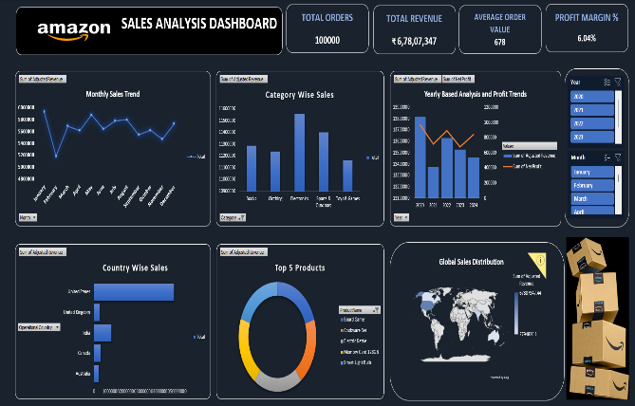

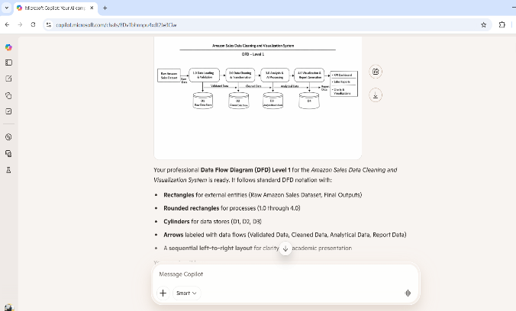

Live Demo of Project
Here's the list of some demo screenshots / features of the project:
Demo 1 : Dashboard
Demo 2 : Key Formulae
Demo 3 : Copilot Assistance
I developed an interactive sales dashboard showing key KPIs such as total revenue, profit margin, and average order value, along with trend and category-wise analysis.
I implemented advanced Excel formulas to automate calculations like adjusted revenue and quarterly segmentation.
I integrated Microsoft Copilot, which assisted in generating the Level-1 Data Flow Diagram and improving system structure.

Slide 8
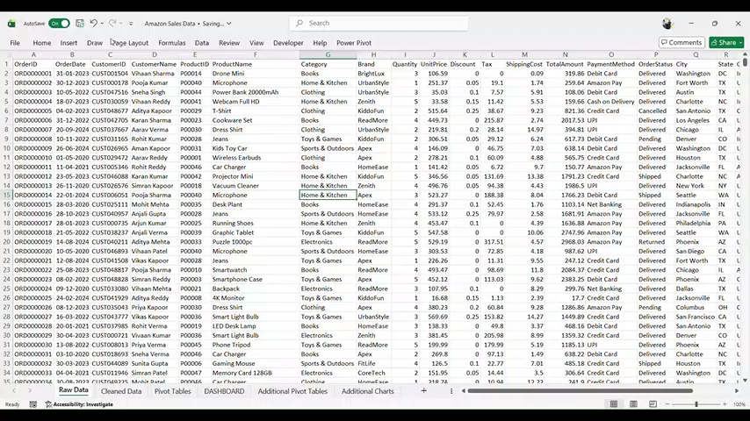
Video of Project Demo
https://drive.google.com/file/d/14s4POWjxs-btjc1FQbXxKUto1RH57PEB/view?usp=drivesdk
▶
[Insert your project demo video.
You can embed a video your live project.]

Slide 9

Conclusion
The project successfully achieved its objectives by efficiently analyzing over 100,000 Amazon sales records and delivering an interactive dashboard with key performance indicators and visual insights. It demonstrated how Microsoft Excel, combined with AI assistance from Copilot, can handle large datasets to generate meaningful business intelligence for decision-making. The dashboard highlighted sales trends, category and country contributions, top-performing products, and year-wise comparisons, enabling quick identification of opportunities for improvement. Beyond the technical outcomes, the project strengthened practical skills in data cleaning, analysis, visualization, and AI-assisted reporting, while the fellowship experience reinforced the real-world application of business intelligence in driving data-driven decisions.
CONCLUSION

Slide 10

Future Scope
The project can be further enhanced by integrating real-time data connectivity using SQL or cloud-based data sources to automate updates.
Advanced analytical features such as predictive sales forecasting, customer segmentation, and profit optimization models can be incorporated using Power BI or Python for deeper insights.
Scalability can be achieved by expanding the dataset to include multi-year or multi-market analysis.
Additionally, integrating machine learning models for demand prediction and return analysis can significantly improve strategic decision-making and extend the overall impact of the project.

Slide 11
Thank You
AICW Fellowship | Student Project Presentation 2026
LinkedIn | Edunet Foundation

